Slide 1
Machine Learning-Driven Initial Guess Prediction for SCF Procedures
Supervised by Prof. Andreas Hauser & Ralf Meyer
Notes:
Thank you all for coming to the presentation of my master’s thesis Machine Learning-Driven Initial Guess Prediction for SCF Procedures.

Slide 2
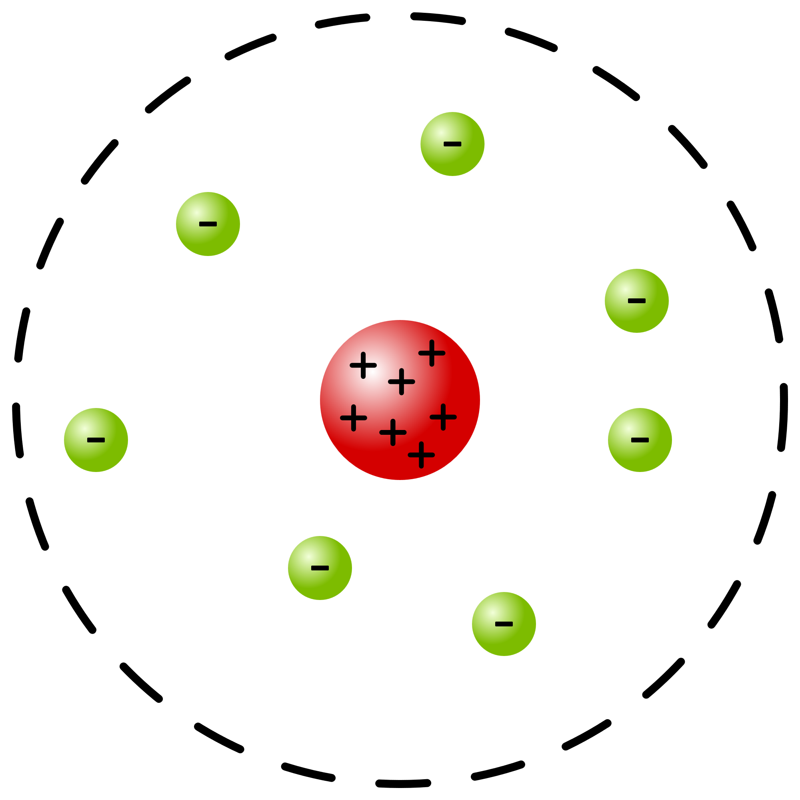
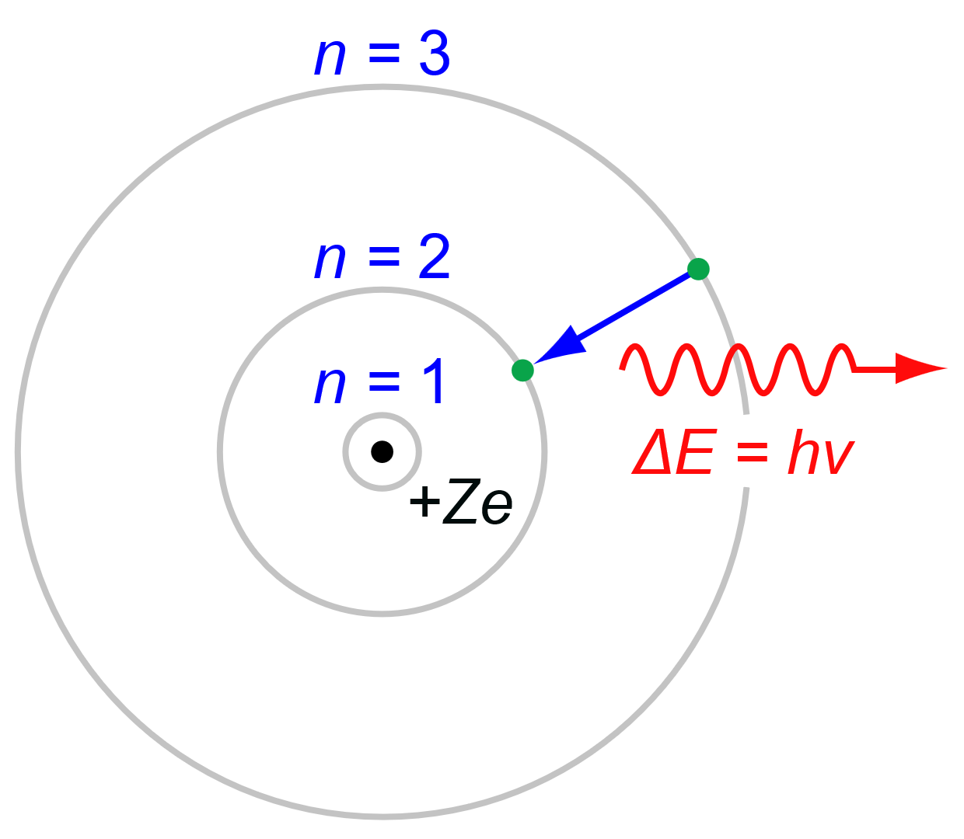
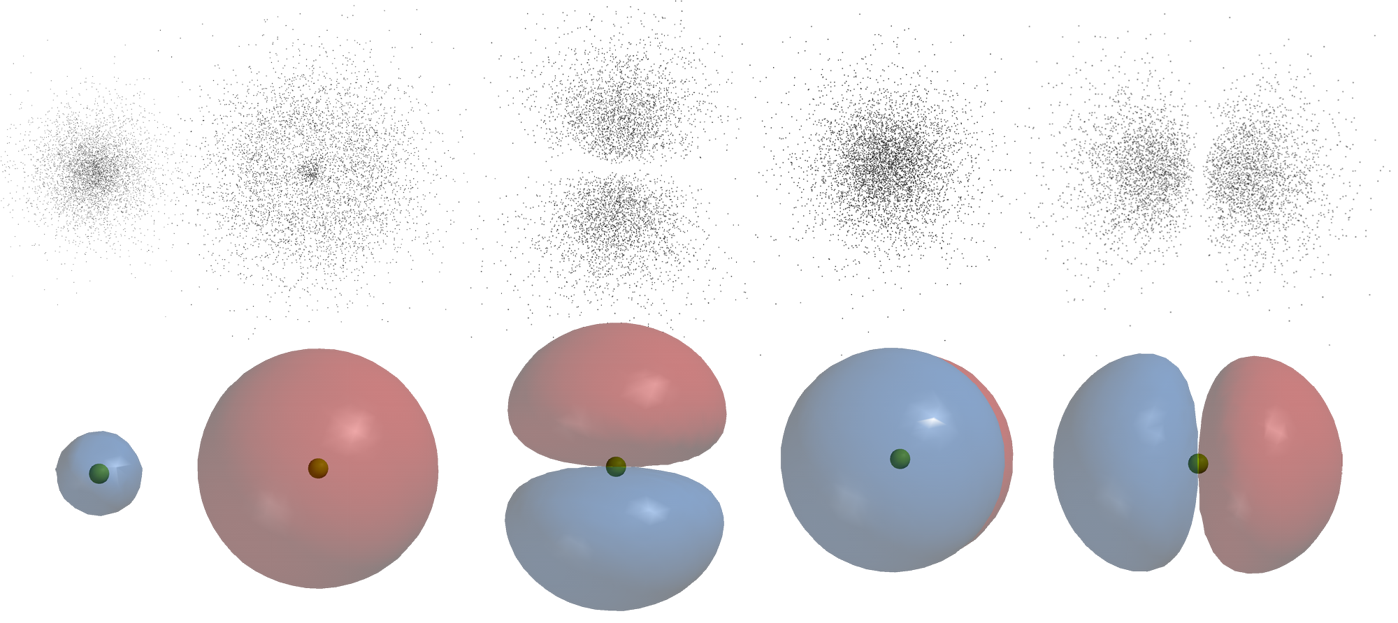
Towards Molecular Simulations
Mathematical formulation of QM 1925
Hartree-Fock method 1927
Density functional theory (Kohn-Sham) 1965
Rosenblatt Perceptron 1957
Deep Blue beats Kasparov 1997
Alpha Fold (GNN) 2018
Goal: find ground state electron distribution
Notes:
Sept. 1925 → first mathematical formulation by Heisenberg

Slide 3
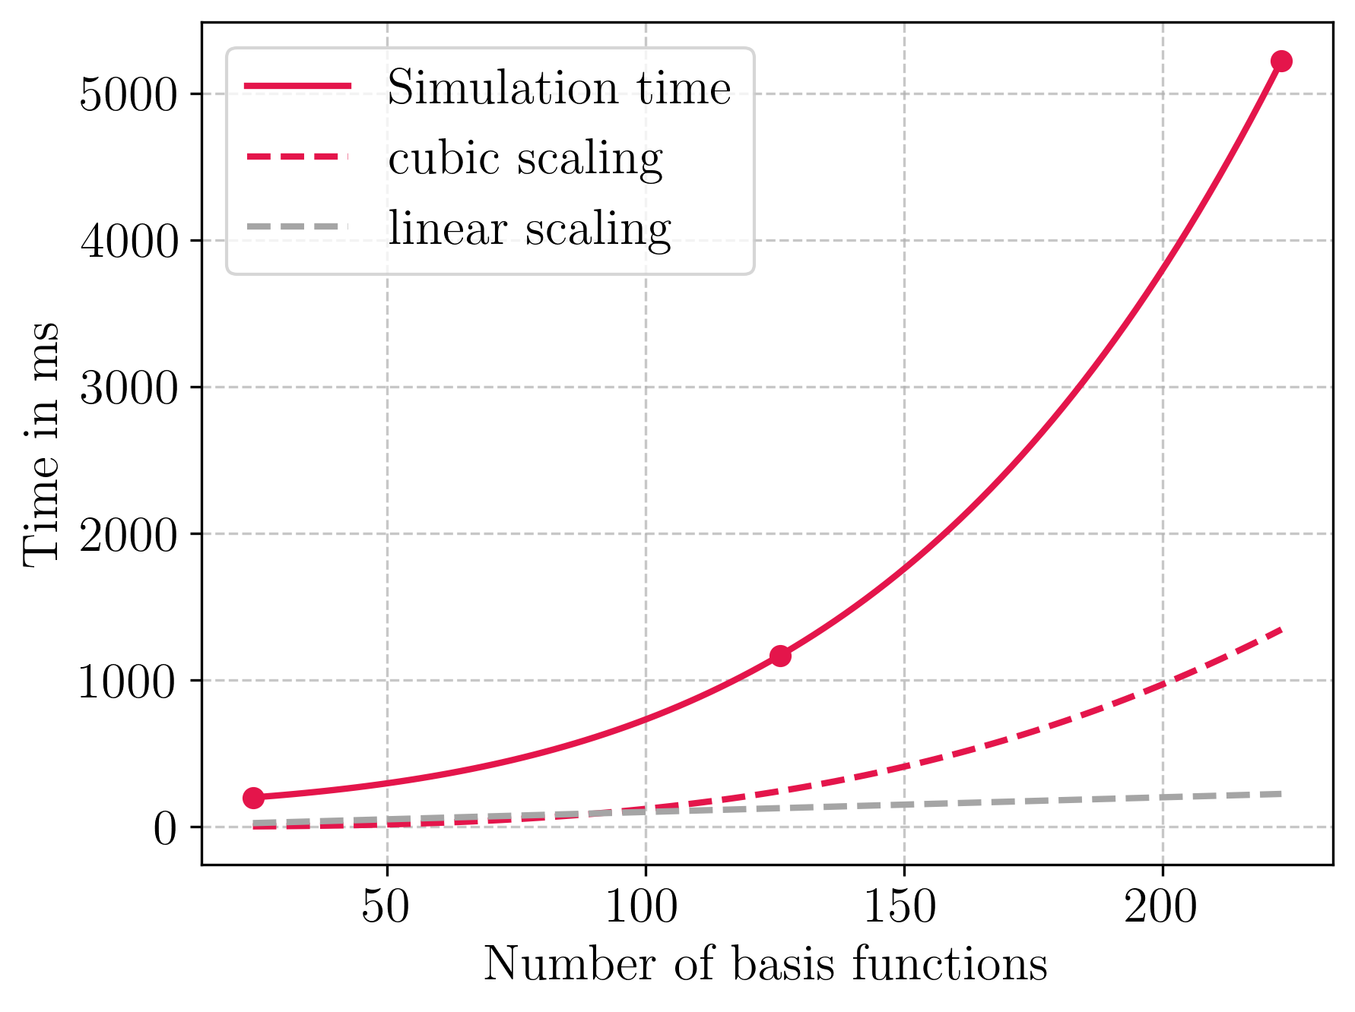
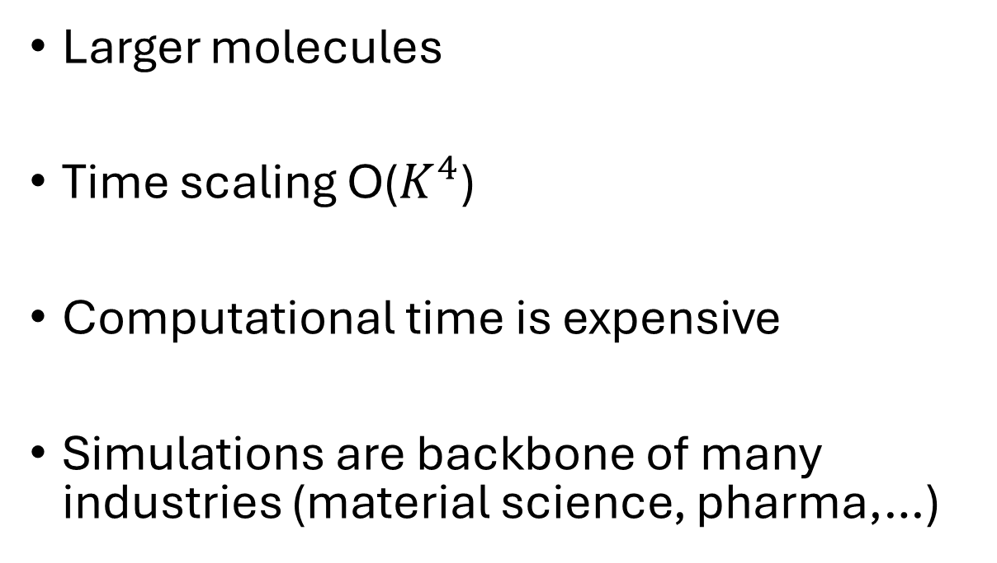
Time is (still) gold
Larger molecules
Time scaling O($K^{4}$)
Computational time is expensive
Simulations are backbone of many industries (material science, pharma,…)
Construct a good guess → reduce computational time
Notes:
Talk about our Problem

Slide 4
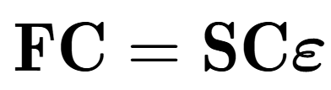
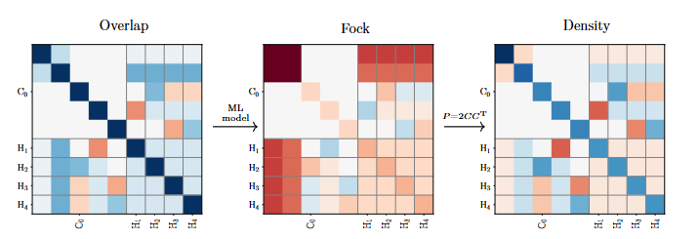
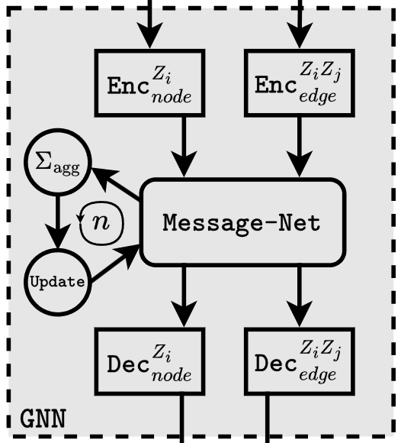
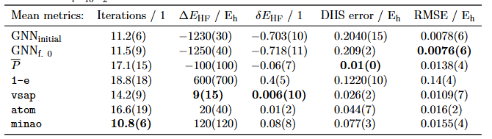
Outline
Background
Fock matrix prediction
Graph Neural Nets
Application

Slide 5
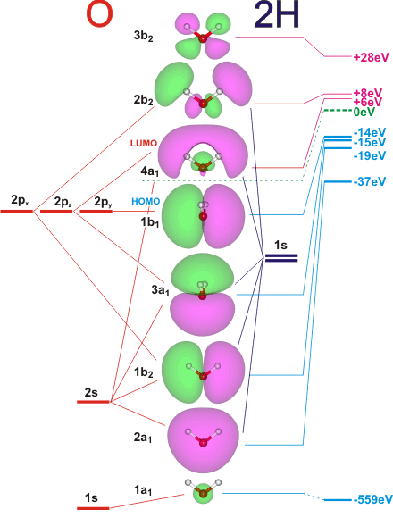
Self-consistent Field (SCF) - Theory
Background – SCF Theory
Electronic wavefunction
Time independent Schrödinger equation
Minimize energy of wavefunction
Constrained by orthogonality of orbitals
Notes:
Exact treatment impossible -> approximate

Slide 6
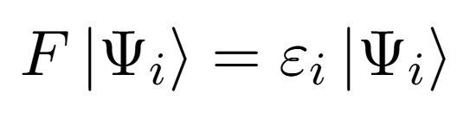
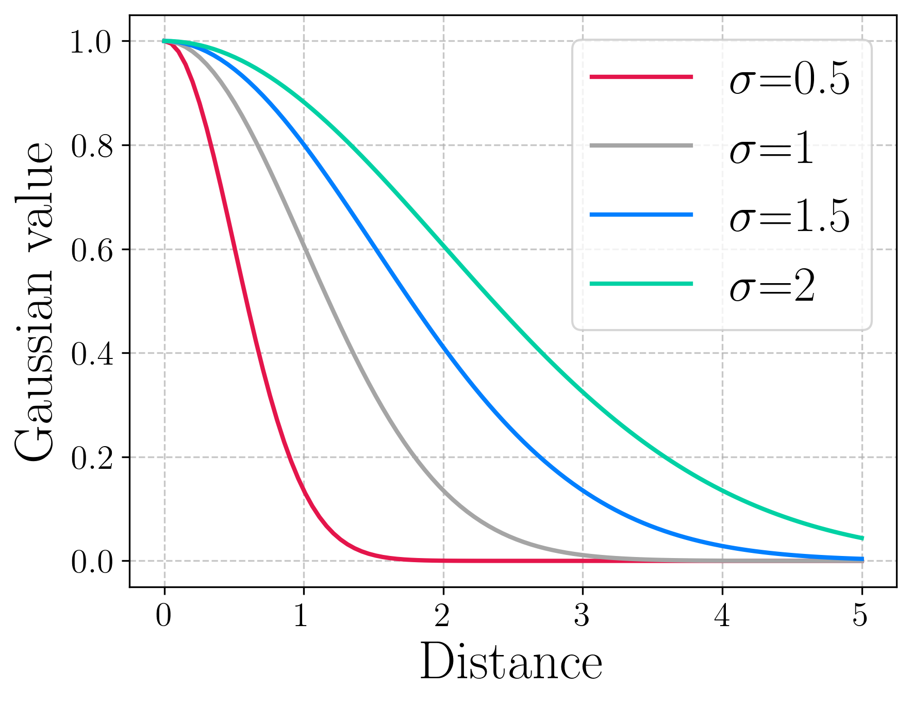
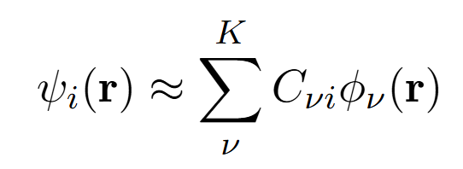
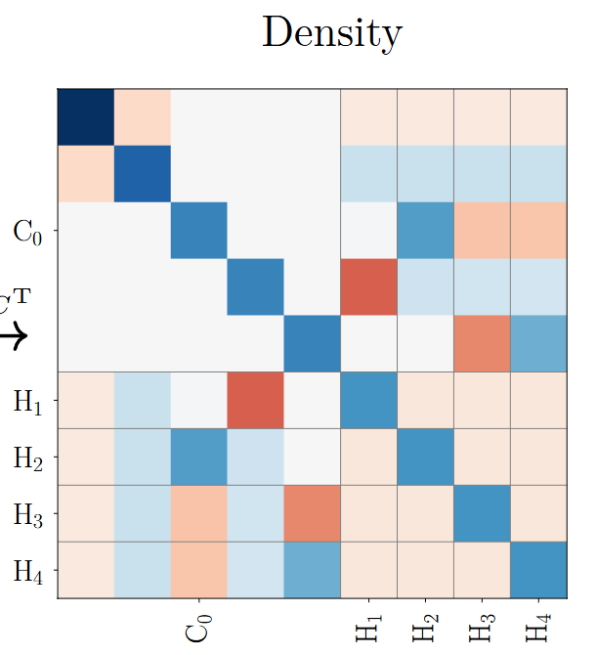
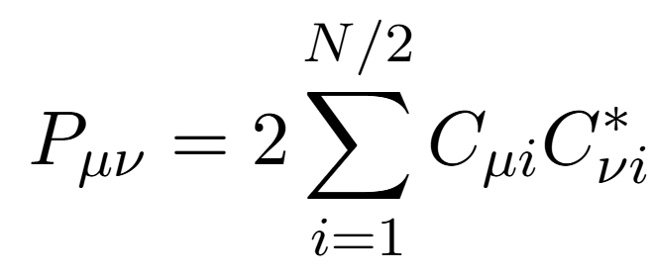
Self-consistent Field (SCF) - Algorithm
Background – SCF Theory
Hartree-Fock eigenvalue equation
Discretize to matrix form (basis sets)
Guess initial state
Solve self-consistently
Notes:
Laguerre polynomials (radial)

Slide 7
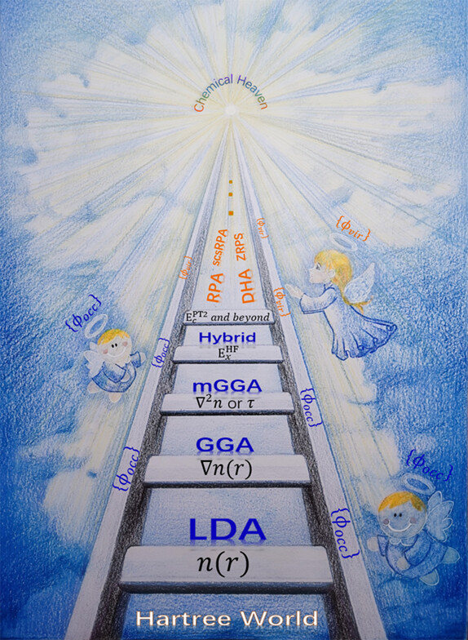


Self-consistent Field (SCF) - DFT & Guesses
Background – SCF Theory
Density Functional Theory (DFT)
B3LYP (Hybrid-GGA)
Generalized Wolfsberg-Helmholtz (GWH) guess
SAD / MINAO guess
Notes:
Density Functional Theory in its Kohn-Sham form uses the fact of the Hohenberg-Kohn theorems to state that the ground state energy of a many-electron system is a functional of the electron density. And the density which minimizes the energy gives the ground state.
B3LYP is Rung 4 (John Perdews – Jacob Ladder) functional in DFT – This means it uses methods from the first 3 rungs: GGA (General Gradient approximation) + mixes in some HF energy. Furthermore, it adds LYP corrections.
Generalized Wolfsberg-Helmholtz takes the diagonal part of Core Hamiltonian (explain: Kinetic part + potential part w.r.t. nucleus) and constructs off-diagonals by weighing using the overlap matrix (1-e integrals).
SAD / MINAO guesses: Calculate on minimal basis AO -> then build a superposition of these and project to given basis
Extra on LYP: Recasts Colle-Salvetti formula for electron pair correlation into DF expression – by expressing correlation energy density in terms of the local electron density and its gradients. Express molecular correlation energies

Slide 8
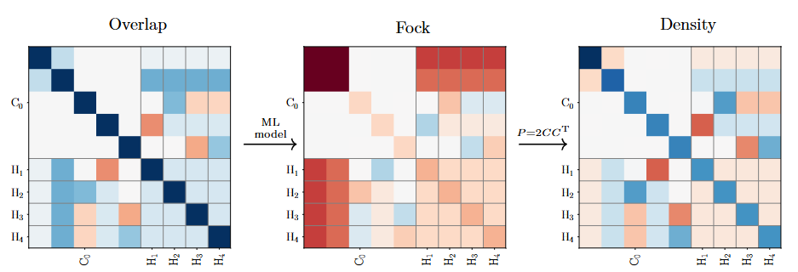
Machine Learning
Background – Machine Learning
Artificial Intelligence
Machine Learning (ML) subfield of Artificial Intelligence (AI)
Supervised
Regression problem
Treatment as Blackbox prediction model
Machine
Learning
Unsupervised
Learning
Supervised
Learning
Reinforcement
Learning
ML
Blackbox
Label
Notes:
AI: general human like behaviour
ML: uses data to learn general concepts to apply to new data.

Slide 9
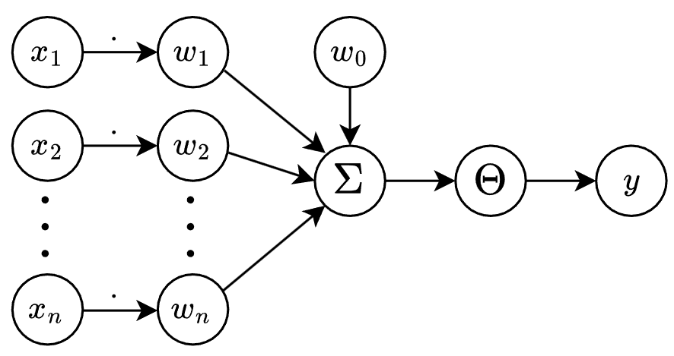
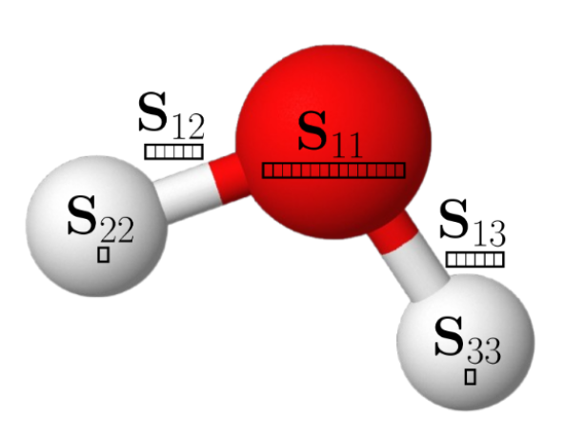
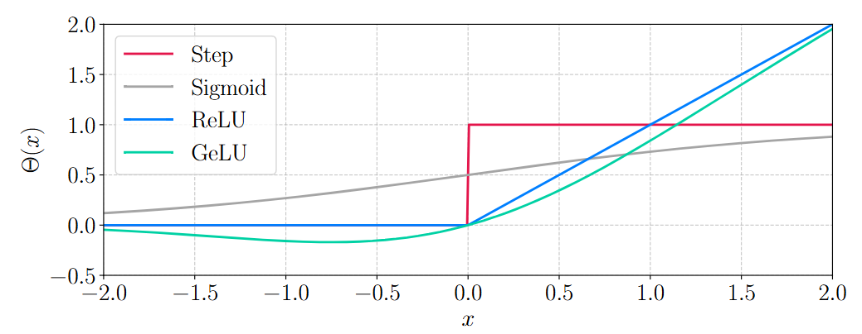
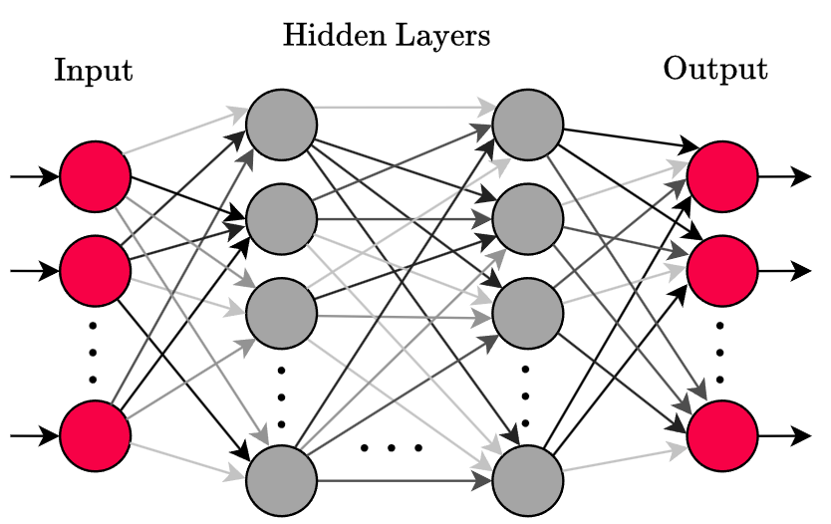
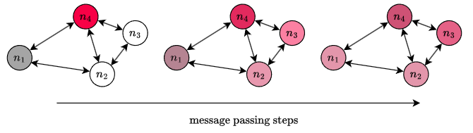
Build the Network
Background – Machine Learning
Perceptron models neuron
Connect multiple Perceptrons to a Neural Network
Represent data in a graph
Message passing

Slide 10
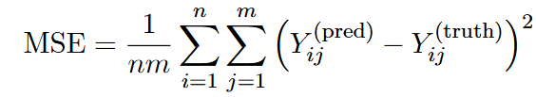
Train the Network
Background – Machine Learning
Use loss function to train
Backpropagation of loss to update weights
Evaluation on unseen data

Slide 11
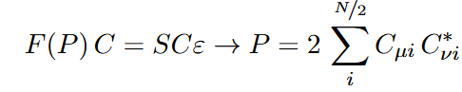
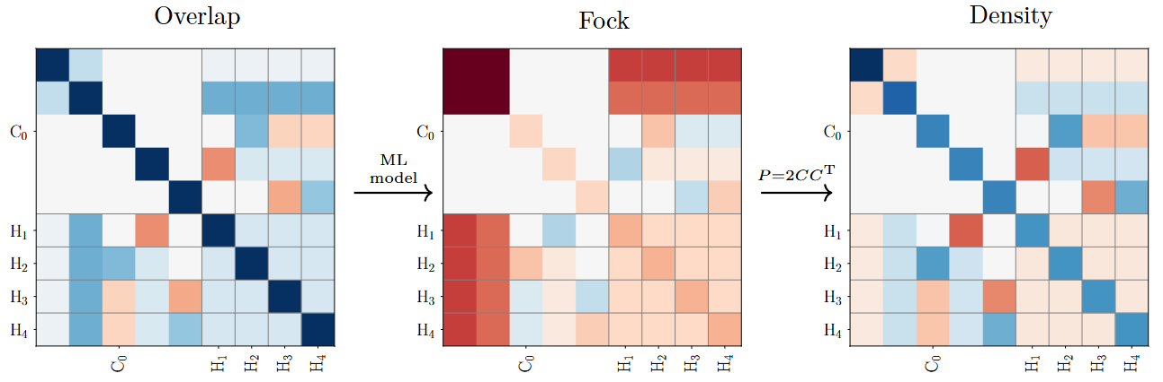
Prediction Workflow
Fock Matrix prediction
ML Blackbox guesses Fock matrix
Construct density for initial guess from that
Notes:
Let’s start with an approach based on Fock matrix prediction!

Slide 12

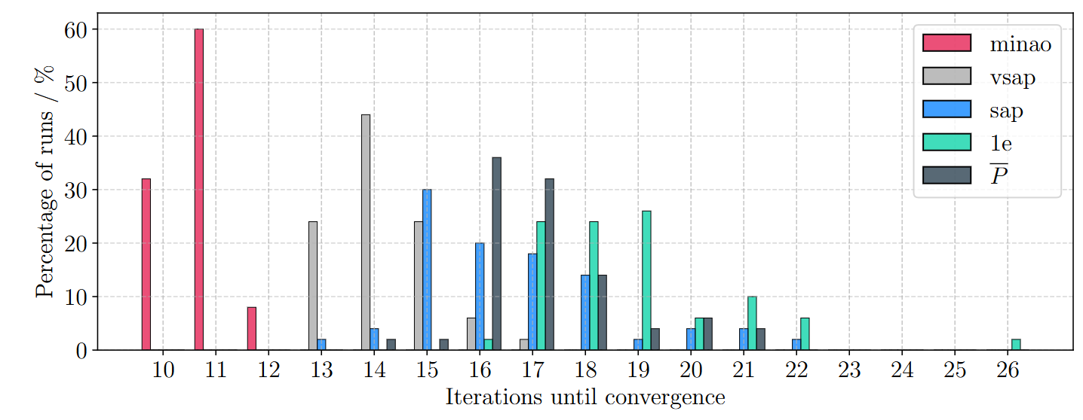
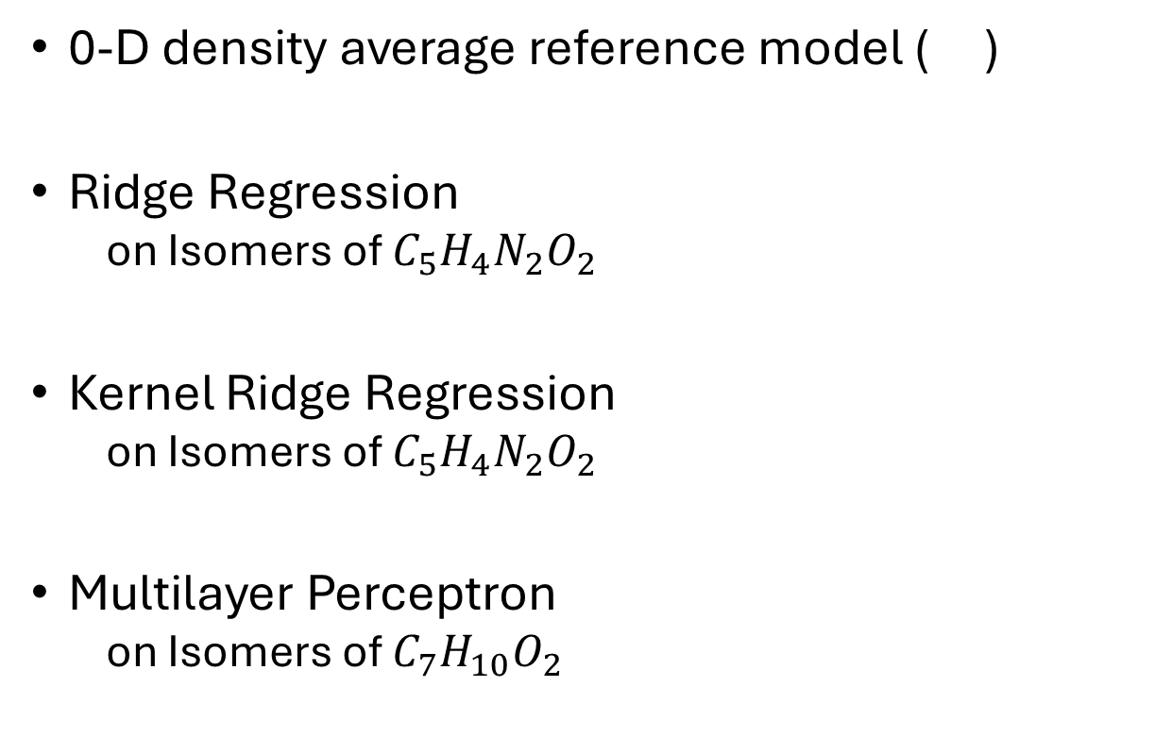
Machine Learning Methods
Fock Matrix prediction
0-D density average reference model ( )
Ridge Regression
on Isomers of $C_{5}H_{4}N_{2}O_{2}$
Kernel Ridge Regression
on Isomers of $C_{5}H_{4}N_{2}O_{2}$
Multilayer Perceptron
on Isomers of $C_{7}H_{10}O_{2}$

Slide 13
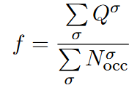
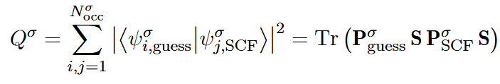
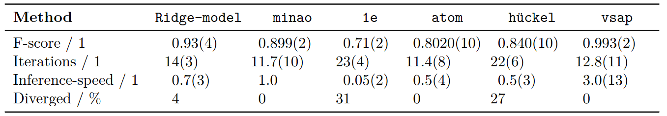
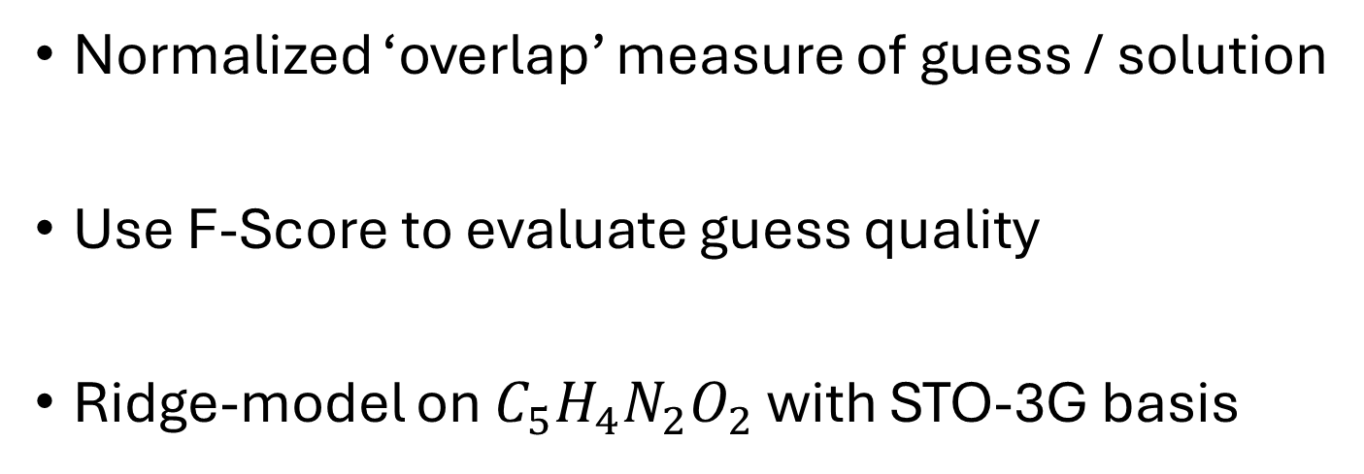
Benchmarking - F-Score
Fock Matrix prediction
Normalized ‘overlap’ measure of guess / solution
Use F-Score to evaluate guess quality
Ridge-model on $C_{5}H_{4}N_{2}O_{2}$ with STO-3G basis

Slide 14
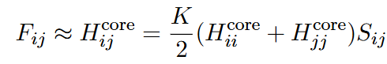
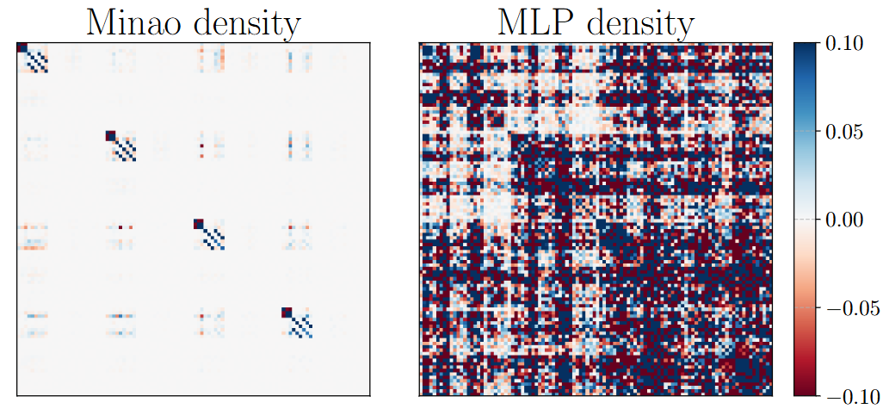
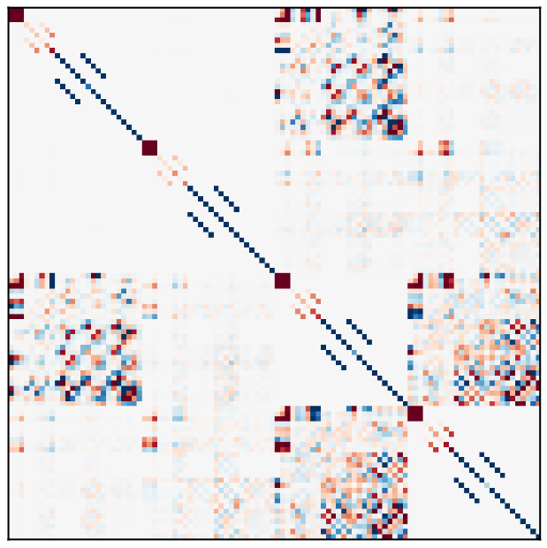
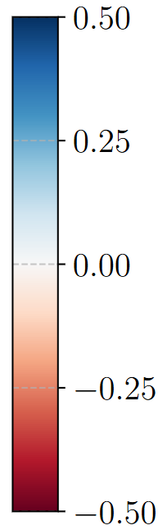
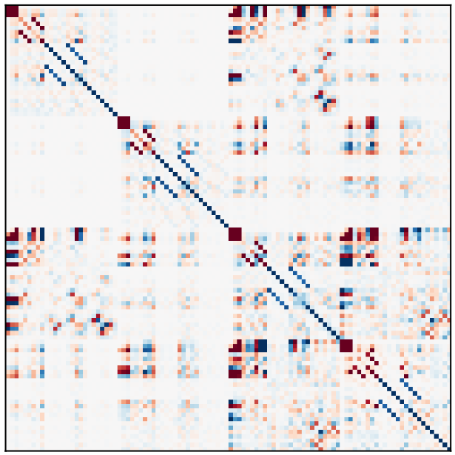
Multilayer Perceptron
Fock Matrix prediction
ML prediction using GWH reconstruction
MLP prediction for Fock matrix
MINAO guess for Fock matrix
Reconstruction from Fock guess fails

Slide 15
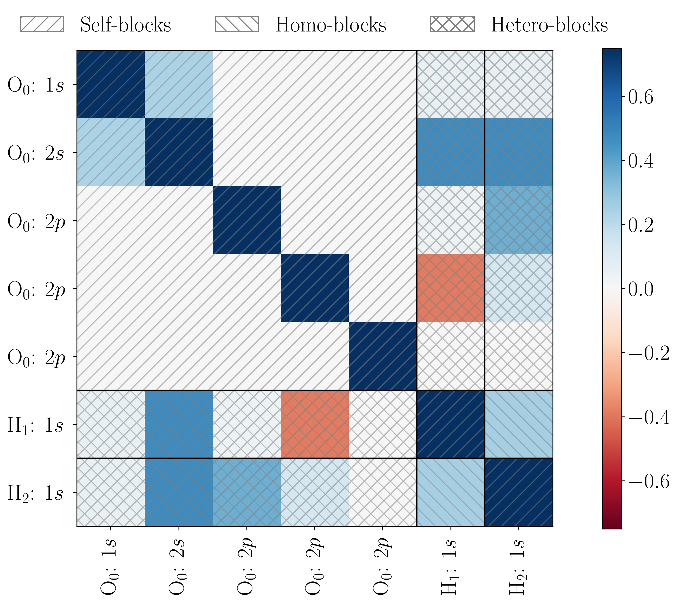
Matrix to Graph
Graph Neural Networks
Split Matrix into blocks
Nodes: Self-blocks
Edges: Homo- / Hetero-blocks
Data augmentation & normalization

Slide 16
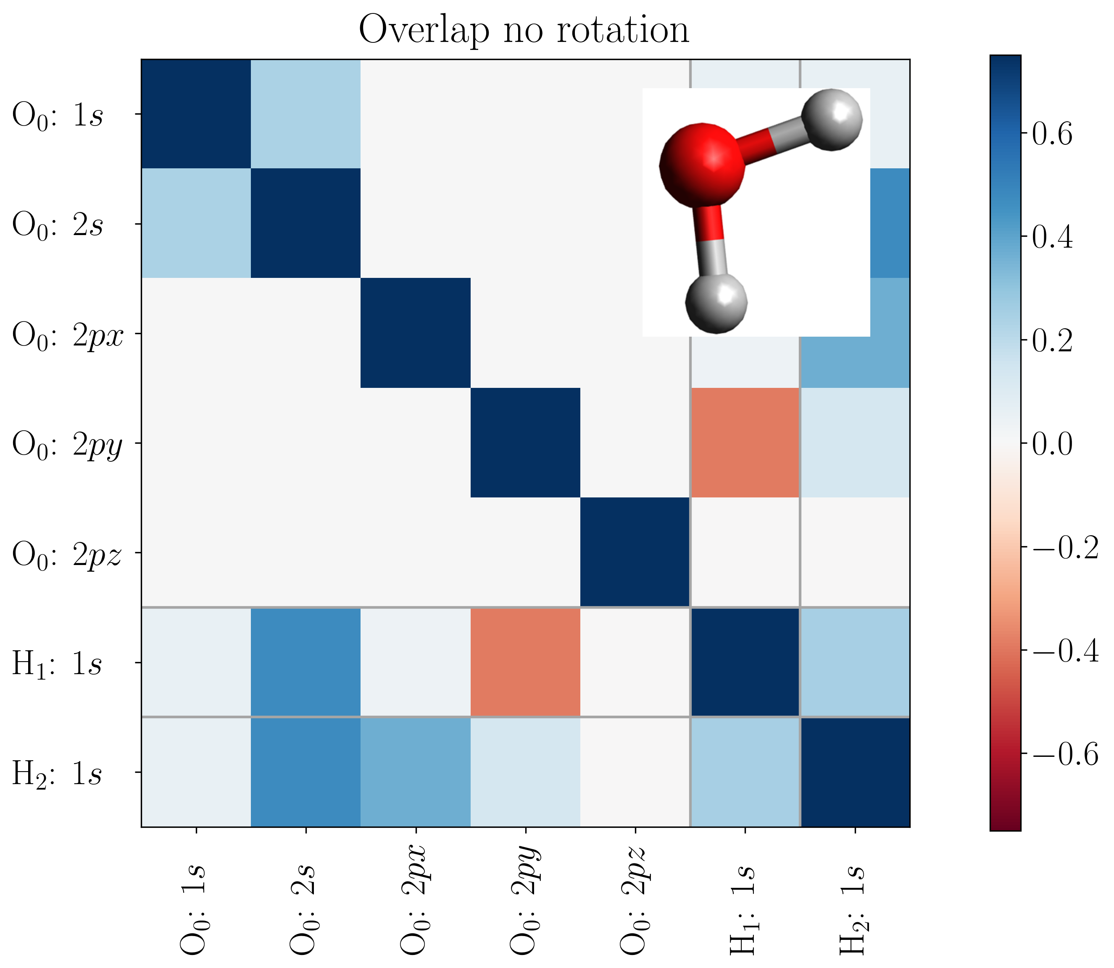
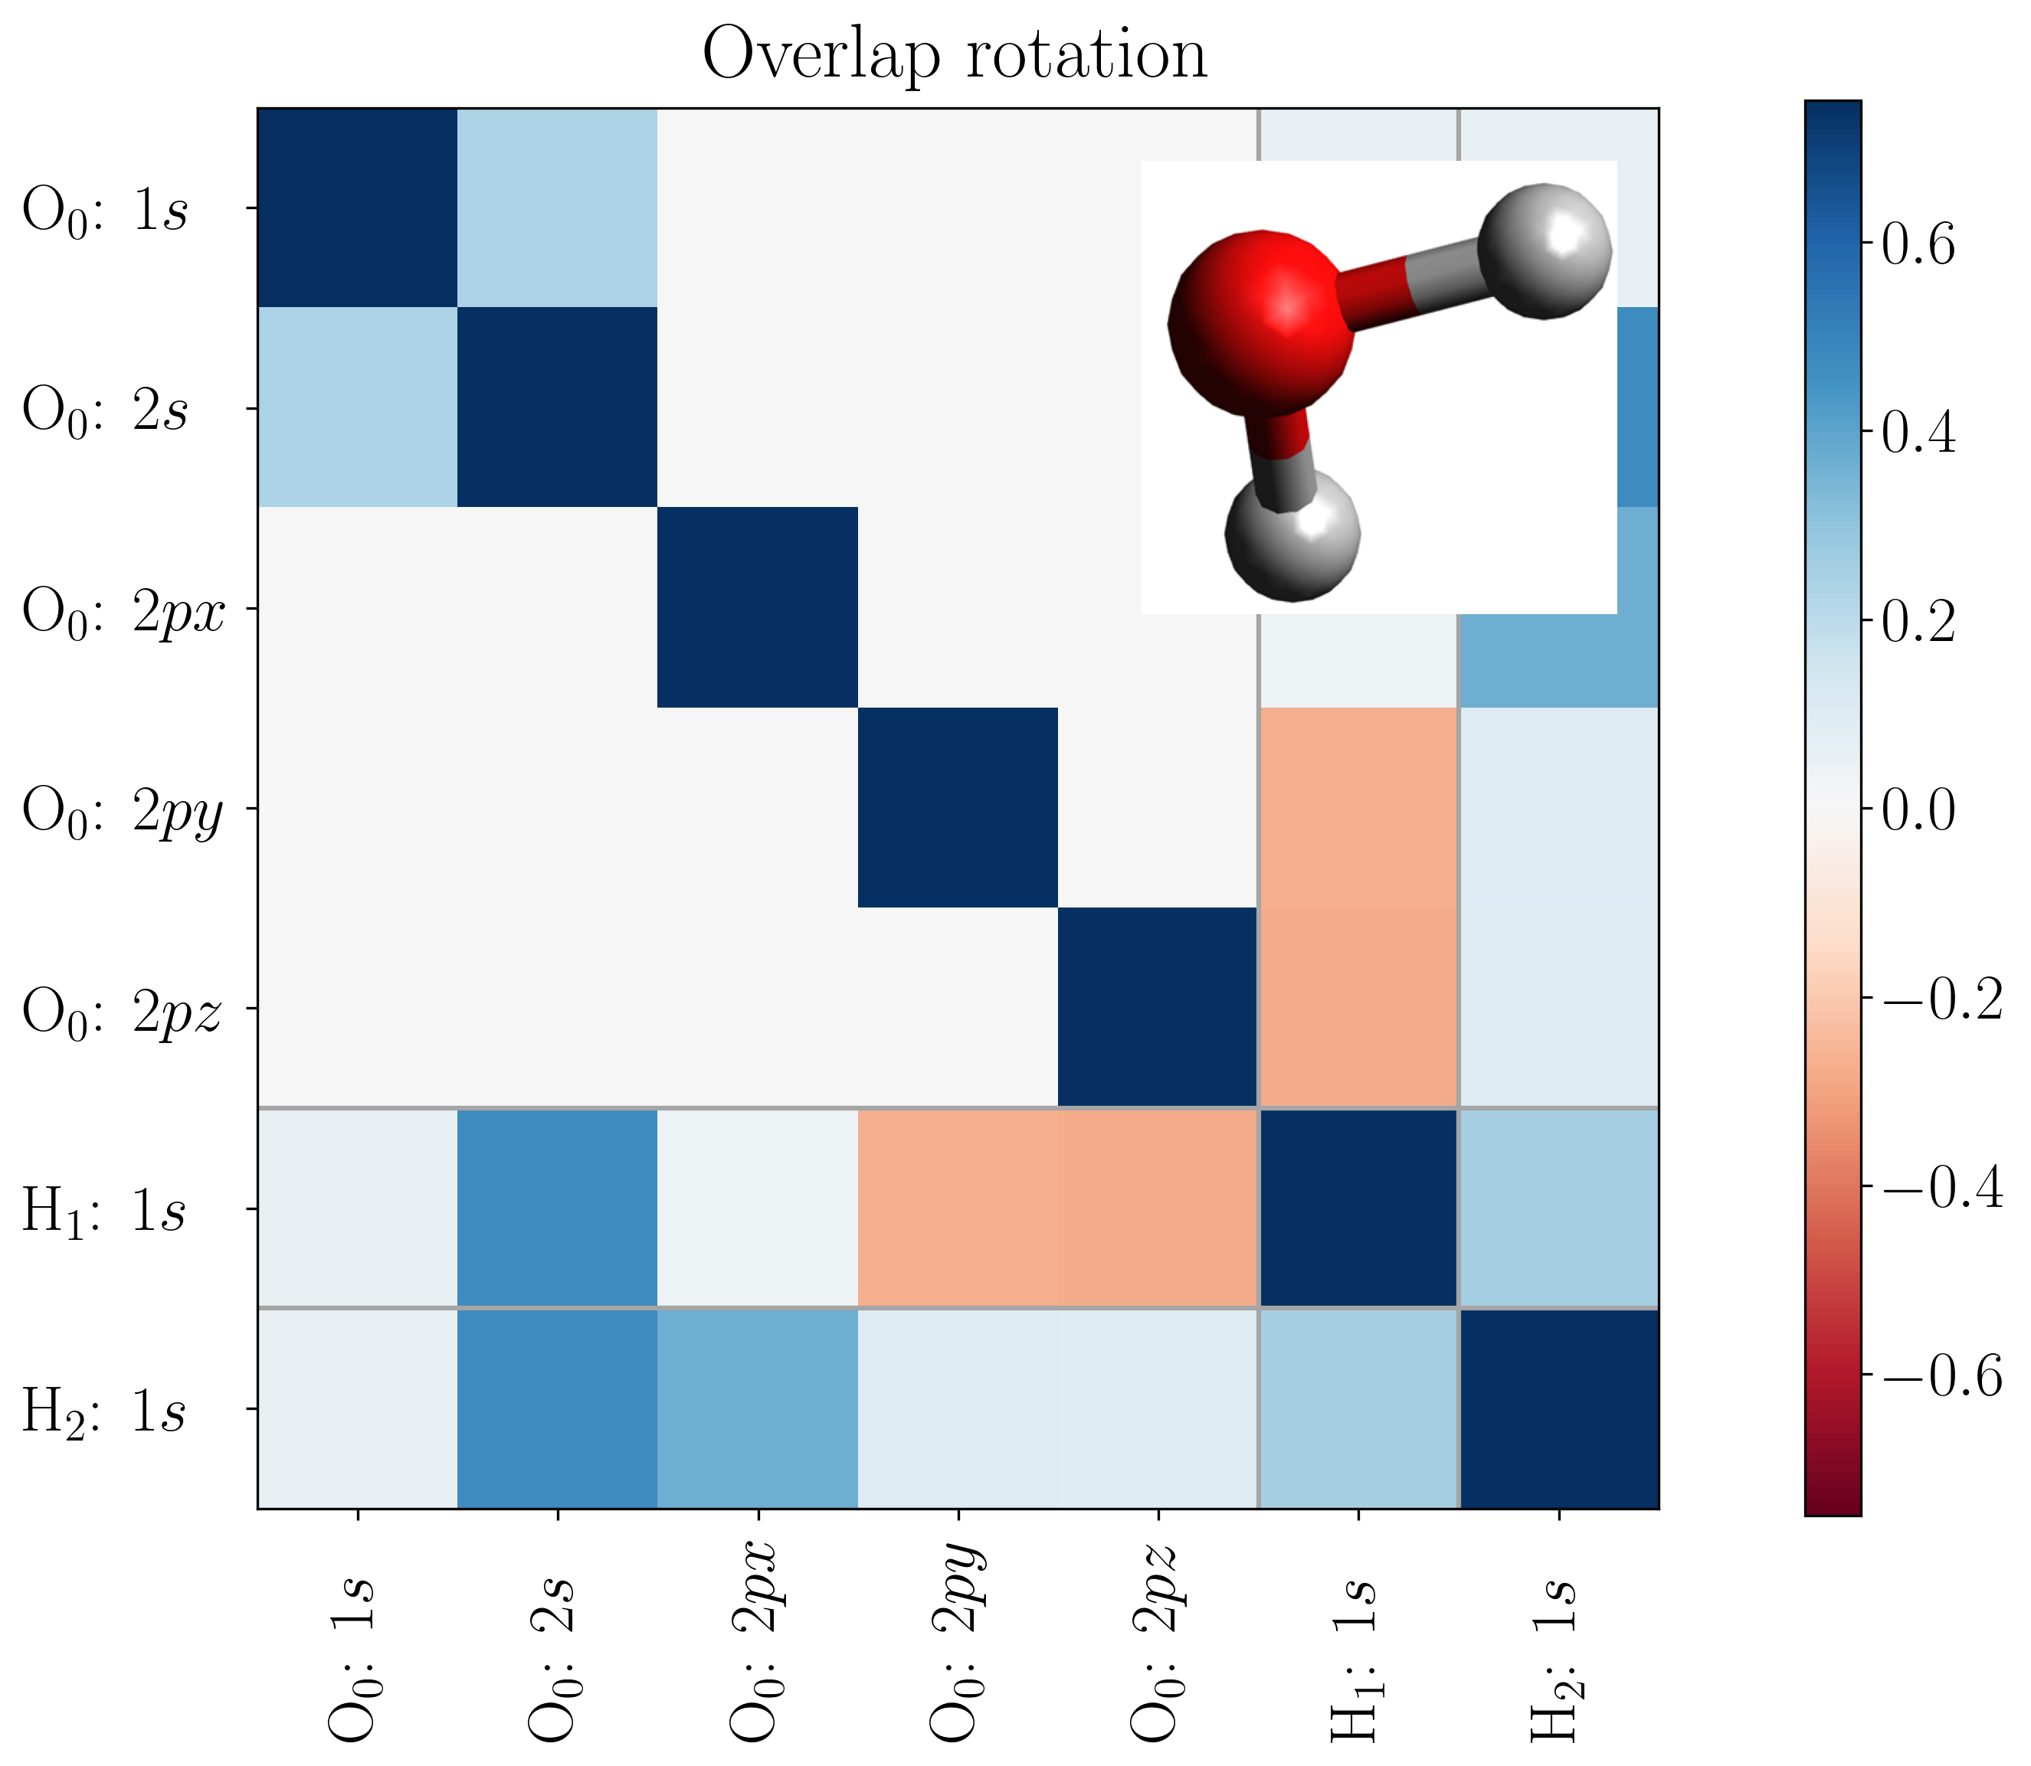
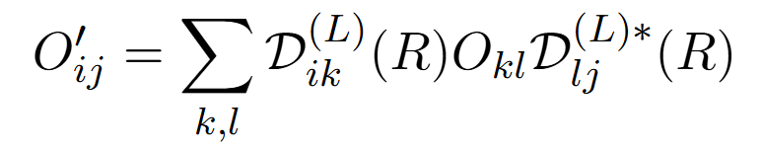
Data augmentation
Graph Neural Networks
Matrices don’t simply rotate
Wigner D-matrices
Randomly sample axis & angle
Normalization

Slide 17
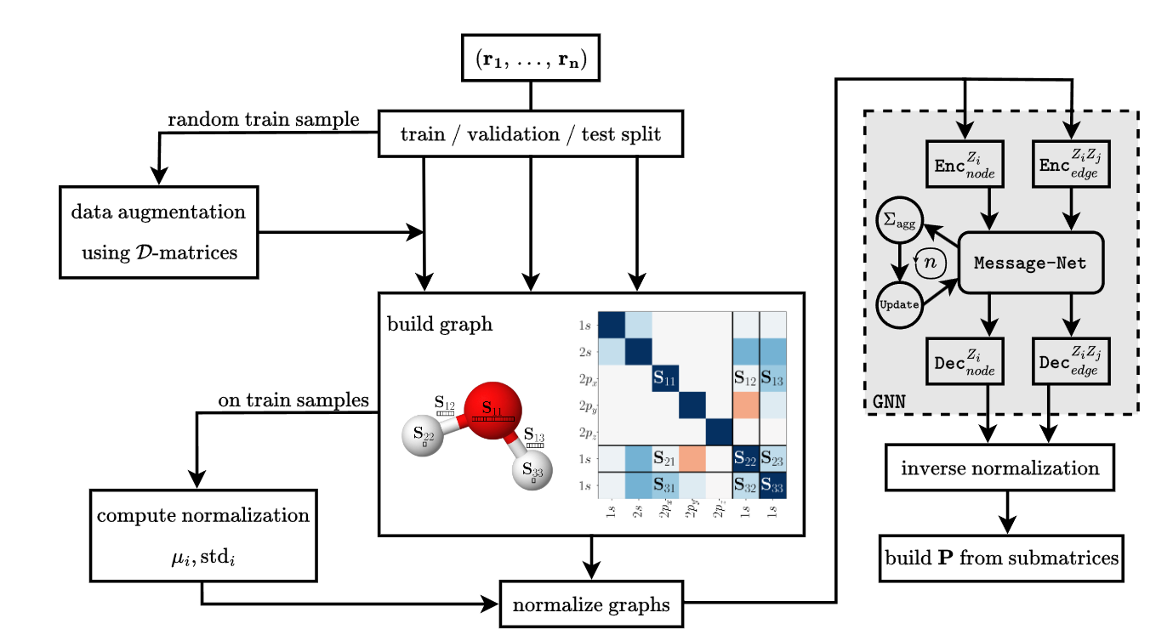
Network Pipeline Design
Graph Neural Networks

Slide 18
Implementation Details – Encoder / Decoder
Graph Neural Networks
Encoders
Adaptive Encoder / Decoder Setup
Adaptive Message Net Setup
Custom collating and batching of data
O – self-block
overlap
H-H – homo-block
overlap
O-H – hetero-block
overlap
25
|r|
130
|r|
351
Linear
Linear
Linear
256
GELU
256
GELU
256
GELU
Linear
Linear
Linear
256
256
256
O – self block
hidden rep.
H-H – homo-block
hidden rep.
O-H – hetero-block
hidden rep.
Decoders
O – self block
hidden rep.
256
351
O – self-block
density
Linear
…

Slide 19
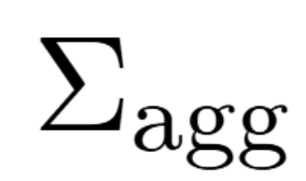
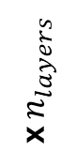
Implementation Details – Message Net
Graph Neural Networks
Message Net
Simple Linear design
Dropout for regularization
Messages update node rep.
src, tgt, edge
15 + 351 + 130
Linear
x $n_{layers}$
256
GELU
Dropout
256
Linear
256
GELU
message
Updaters
O – self block
hidden rep.
256
256
256
O – self-block
updated rep.
Linear
GELU
Linear
…
Neighbour agg.

Slide 20



Implementation & Training
Graph Neural Networks
Implementation in PyTorch Geometric
AdamW as optimizer
Hyperparameter optimization
Ray Tune
Asynchronous Successive Halving (ASHA)
Benchmark: Iterations on test set
Simulation: PySCF

Slide 21
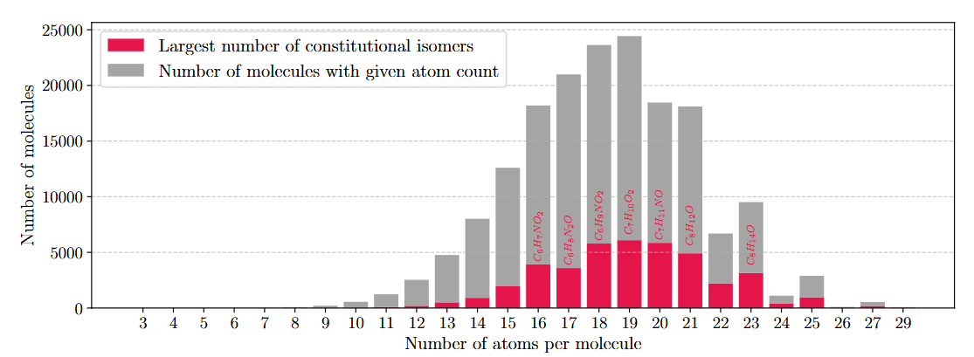
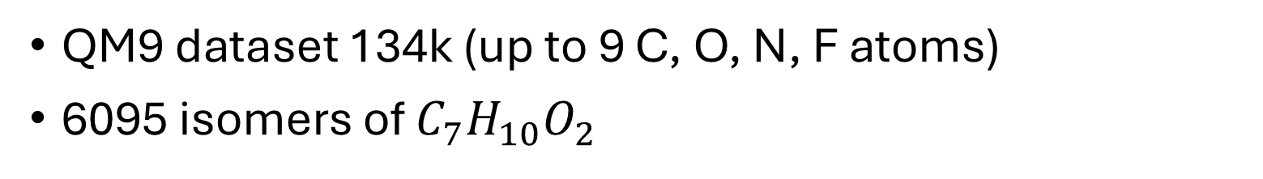
Dataset – QM9
Application - Dataset
QM9 dataset 134k (up to 9 C, O, N, F atoms)
6095 isomers of $C_{7}H_{10}O_{2}$

Slide 22
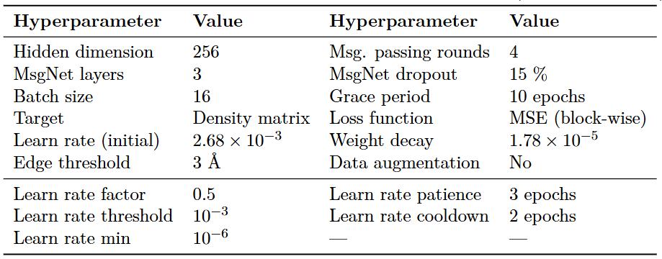
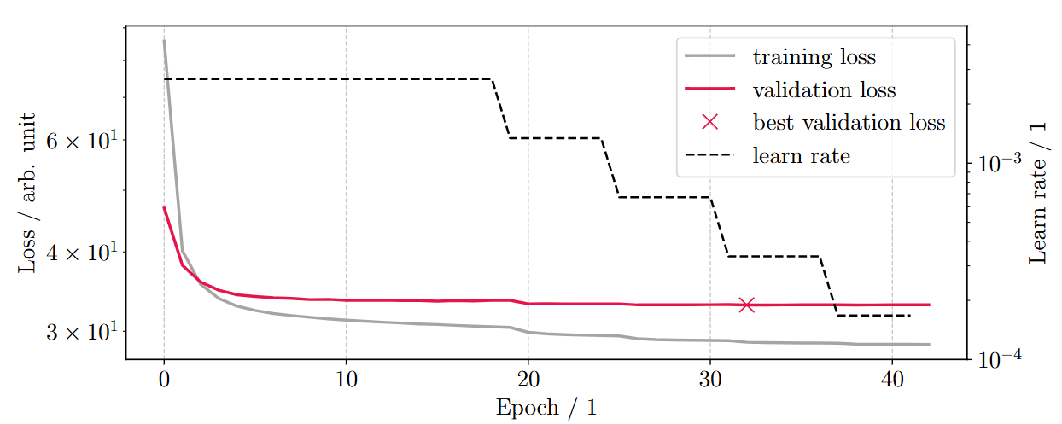

QM9 - $C_{7}H_{10}O_{2}$ Isomers
Application – QM9 Isomers
Trained on 400 samples
50 validation, 50 test
Data augmentation has no influence on validation loss (only train)
Low edge threshold bad

Slide 23
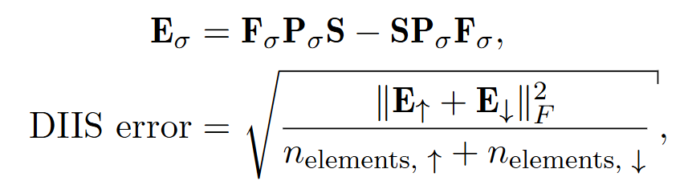
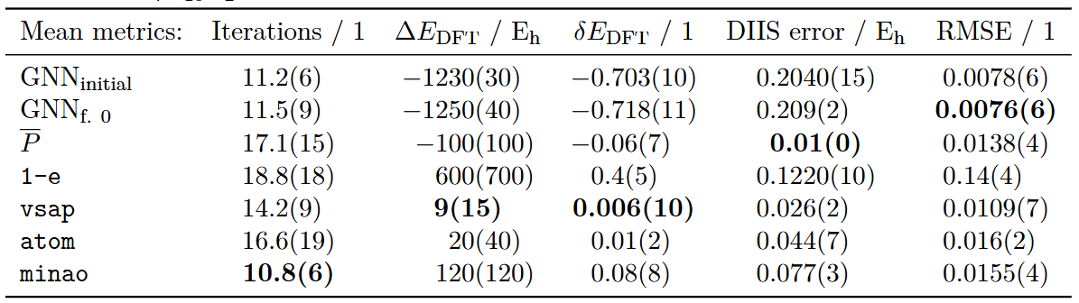
QM9 - $C_{7}H_{10}O_{2}$ Isomers
Application – QM9 Isomers
Beats all schemes except MINAO
RMSE drastically better, Energy and DIIS significantly worse

Slide 24
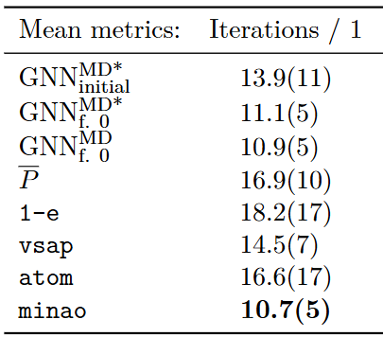

QM9 - $C_{7}H_{10}O_{2}$ Isomers MD
Application – QM9 Isomers MD
500 samples from MD simulations
Comparable to MINAO
Notes:
113 isomers from the QM9 C7H10O2

Slide 25


QM9 – Stratified sample
Application – QM9 sample
Limited train size on varied data
Higher variation in iterations

Slide 26
Inference and Training metrics
Application
Inference time 3 orders of magnitude lower than DFT simulation
Trainable on small datasets ~ 400 molecules
Strong performance with few train epochs

Slide 27
Conclusion & Outlook
Conclusion & Outlook
Direct density pred. better than via Fock matrix
Message passing GNN to guess initial density
On par with best classical guesses
Equivariant version of GNN
Extend to other systems
Transition-metal complexes
Heavy-elements (relativistic effects)
Hybrid loss (MSE + energy) via twin networks

Slide 28
Image Sources
Image sources
Von Bensteele1995 - Eigenes Werk, CC BY-SA 3.0, https://commons.wikimedia.org/w/index.php?curid=21332267
Von JabberWok, CC BY-SA 3.0, https://commons.wikimedia.org/w/index.php?curid=2639910
Gemeinfrei, https://commons.wikimedia.org/w/index.php?curid=1474667
https://water.lsbu.ac.uk/water/h2o_orbitals.html
https://wires.onlinelibrary.wiley.com/doi/full/10.1002/wcms.1490
https://github.com/pyg-team/pytorch_geometric
https://pyscf.org/

Slide 29








THANK YOU!
P-36903
Machine Learning-Driven Initial Guess Prediction for SCF Procedures
Notes:
I’m happy to answer all your questions on the topic.

Slide 30
Machine Learning-Driven Initial Guess Prediction for SCF Procedures
Supervised by Prof. Andreas Hauser & Ralf Meyer
Notes:
Thank you all for coming to the presentation of my master’s thesis Machine Learning-Driven Initial Guess Prediction for SCF Procedures.

Slide 31




HF - Derivation
Backup

Slide 32




HF - Derivation
Backup

Slide 33


Density via Fock Matrix – MLP
Backup - Fock Matrix prediction
ML Model with GWH reconstruction
MINAO guess for Fock Matrix

Slide 34




Backup - Graph Neural Networks

